Slide 1

MINOR PROJECT COMMONSENSE VALIDATION – SEN MAKING
GROUP 40 – DEBAL HUSSAIN ABBAS(18BCS046), MAUWAZ AHMED FAROOQUI(18BCS048)
Under the Supervision of Dr. Waseem Ahmed
DEPARTMENT OF COMPUTER ENGINEERING, JAMIA MILLIA ISLAMIA UNIVERSITY

Slide 2
INTRODUCTION
Introducing common sense to natural language understanding systems has received increasing research attention. It remains a fundamental question on how to evaluate whether a system has the sense-making capability. Existing benchmarks measure common sense knowledge indirectly or without reasoning.
In this project, we release a benchmark to directly test whether a system can differentiate natural language statements that make sense from those that do not make sense. The results are evaluated based on the accuracy score.

Slide 3
Natural Language Understanding (NLU) has received increasing research attention in recent years. With language models trained on large corpora, algorithms show better performance than humans on some benchmarks. Compared to humans, however, most end-to-end trained systems are rather weak on common sense.
For example, it is straightforward for a human to understand that someone can put a turkey into a fridge but he can never put an elephant into a fridge with basic commonsense reasoning, but it can be non-trivial for a system to tell the difference.

Slide 4
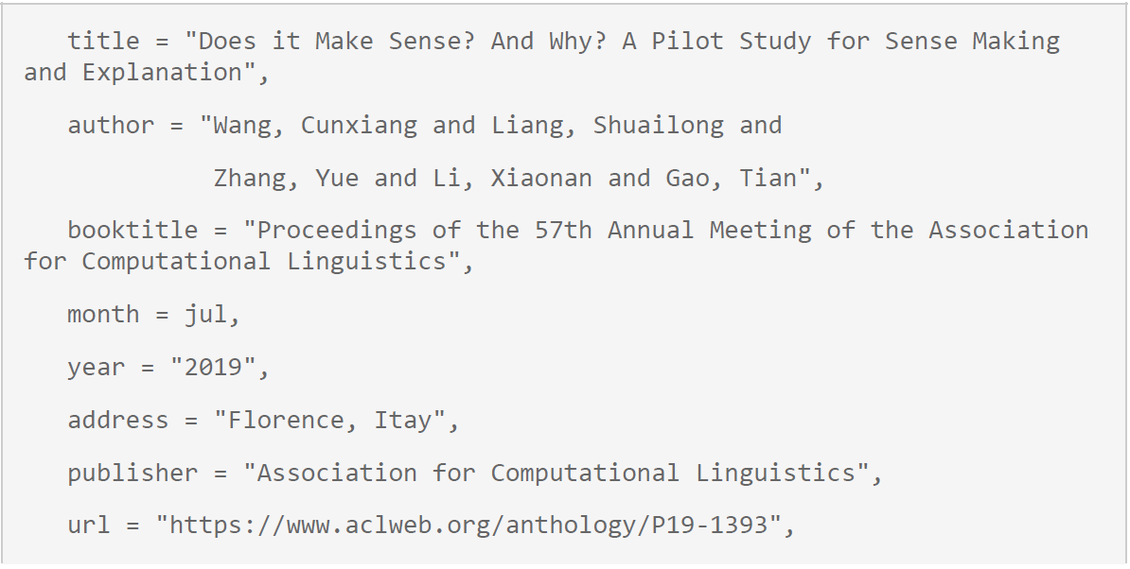
The Research Paper

Slide 5
Existing datasets test common sense indirectly through tasks that require extra knowledge. They verify whether a system is equipped with common sense by testing whether it can give a correct answer where the input does not contain such knowledge.
In this pilot study, we evaluate contextualized representations trained over large-scale language modeling tasks on our benchmark.
Results show that there is still a large gap behind human performance despite that the models are trained over 100 million natural language sentences. Detailed examination shows that inference remains a challenge for such systems.
The research area of the paper became the problem statement for the SemEval-2020 competition.

Slide 6
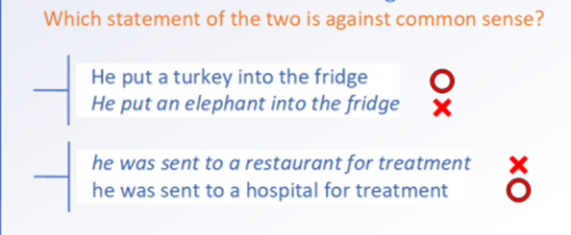
The paper mentions two tasks –
First task is to choose from two natural language statements with similar wordings which one makes sense and which one does not make sense;
The second task is to find the key reason why a given statement does not make sense.
The project is an implementation of the first part of the research paper.

Slide 7
DATASET USED
The dataset was provided by SemEval-2020 competition organisers
The dataset is distributed into Train, Test and Validation subsets. Each instance of the data consists of 2 sentences – sentence0 and sentence1, one of which makes sense while the other does not, the context of both remaining the same.
Alongside the pair of sentences is a number which is either 0 or 1 indicating which of the above statements makes sense. Each instance of data can be identified by a unique id.

Slide 8
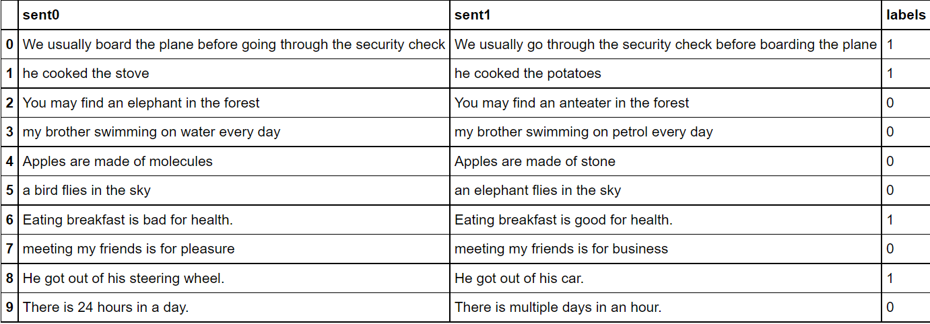

Slide 9
Description of Datasets Provided
 | Total Length of Data | Label = 1 | Label = 0
Train.csv | 10,000 | 4,979 | 5,021
Test.csv | 1,000 | 508 | 492
Dev.csv | 997 | 518 | 479
The frequencies of both classes are almost equal. Hence, we will use ‘Accuracy’ as our metric to evaluate the models

Slide 10
METHODOLOGY USED
We have used two methods here:
Used Sequence Models having a single Bi-Directional LSTM layer having a Single Dense Layer on top of it for prediction
State-of-the-art language models trained over large texts as our baselines, assuming that common sense knowledge is encoded over texts, having a single feed forward layer on top of the transformer language model having two neurons and softmax as activation function.
Used RoBERTa model which is trained on a larger dataset than BERT and has a different training strategy.

Slide 11
Tools and Environment Used
Model training and testing using tensorflow, keras and huggingface library in Google Colab.
We aim to build a web application to implement the same. We will use Flask framework for backend and HTML/CSS for frontend

Slide 12
Sequence Model

Slide 13
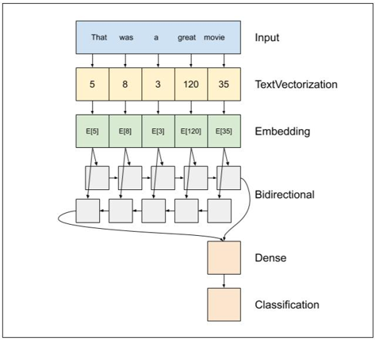
Sequence Model Architecture

Slide 14
Embedding Layer
nv - Vocabulary Size
ne - Embedding Size
An embedding layer takes an index assigned to each word (represented as a one-hot vector with size nv)from your vocabulary and maps it to a representation of that word with a determined embedding dimension (ne)).
For the embedding layer in your model, you'd have to learn a matrix of weights (embedding matrix)E , of size (ne, nv). The size of the embedding could be treated as a hyperparameter in your model.

Slide 15
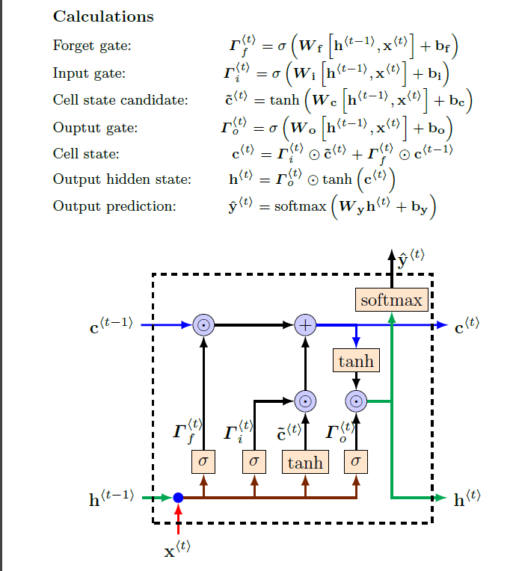
LSTM Layer
Learns when to remember and when to forget
• Anatomy:
A cell state
A hidden state with three gates
a. Forget gate: Decides what to keep.
b. Input gate: Decides what to add.
c. Output gate: Decides what the
next hidden state will be.
-Loops back again at the end of each time step after updating the states.
• Gates allow gradients to flow unchanged (offers a solution to vanishing gradients).

Slide 16
Dense Layer
Dense layer is the regular deeply connected neural network layer.
W : This is the Weight Matrix
A : This is the activation function
Y : Output
Z = W^{T}X + b
Y = A(Z)
Here the Activation Function used is Sigmoid
S(x) = 1/(1+ e^{-x})
The output after applying the Activation function will be the predictions for our model

Slide 17
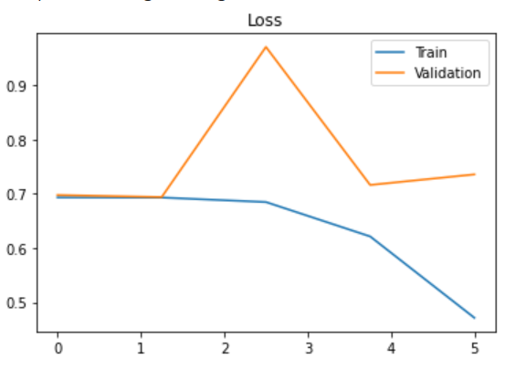
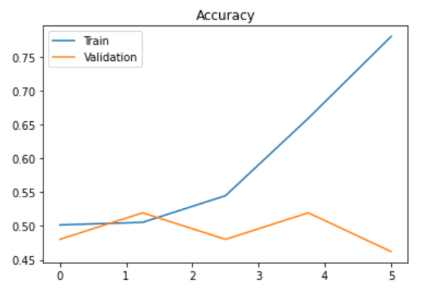
Visualizing Results of Sequence Model
From the above graph we can see that this kind of Sequence model tends to overfit on the training data and gives low accuracy on validation set. We will try to tackle this issue using transformer models

Slide 18
Drawbacks
Parallel computing is difficult to implement.
For long sequences there is loss of information.
We are training the Embedding Matrix from Scratch so the Word Vector Representations are not very good.
Has a tendency to overfit on Training Data

Slide 19
USING TRANSFORMERS FOR MODEL TRAINING

Slide 20
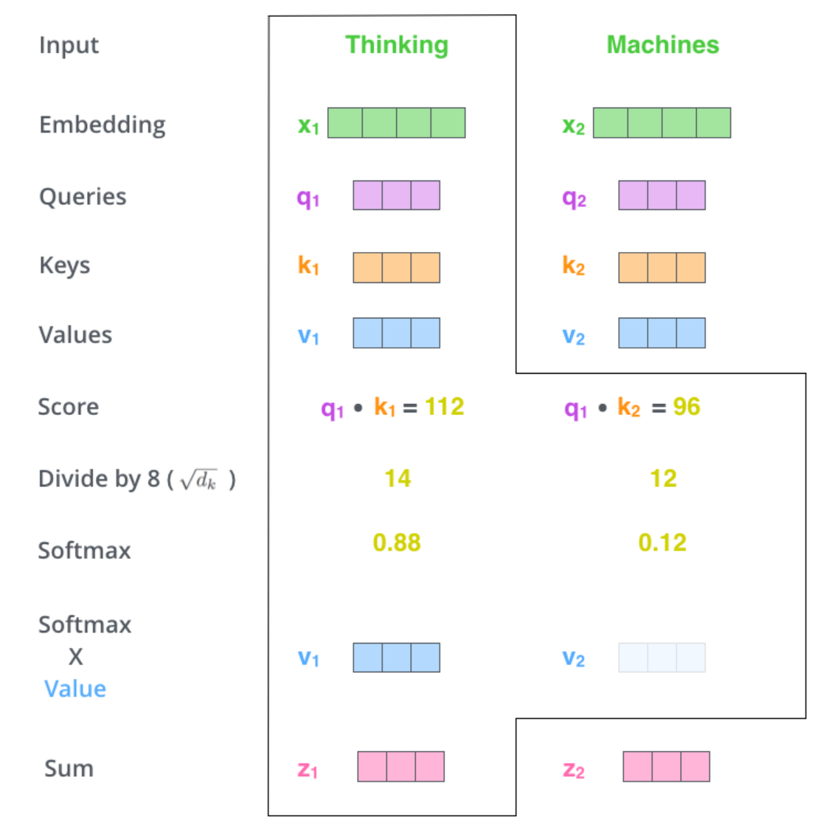
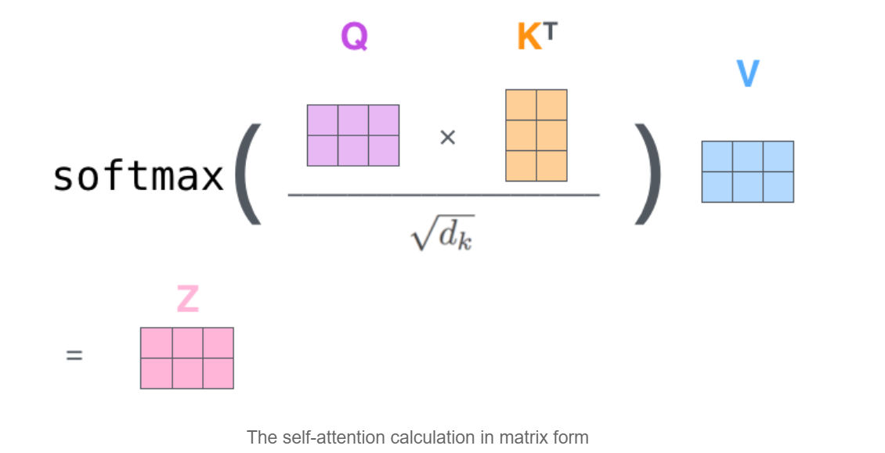
Attention Models

Slide 21
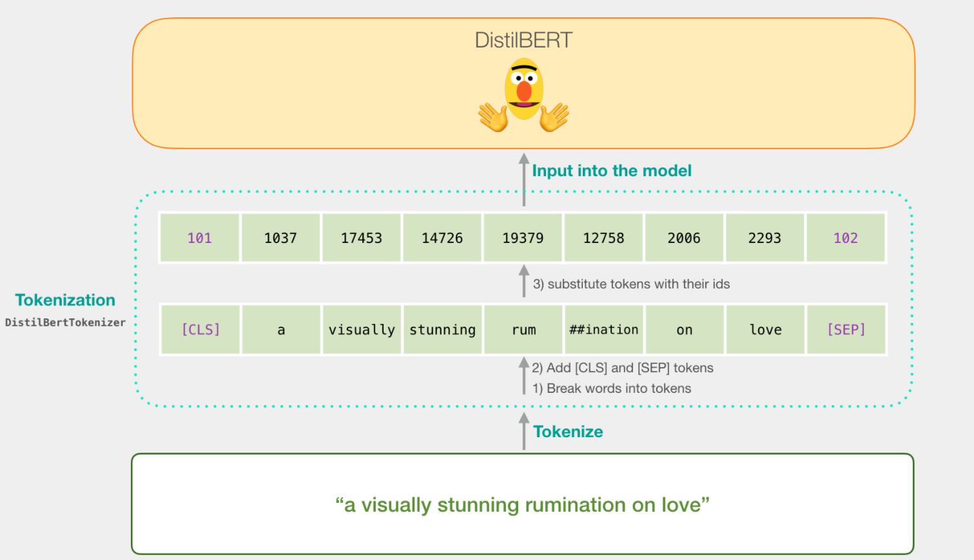
DistilBERT Architecture

Slide 22
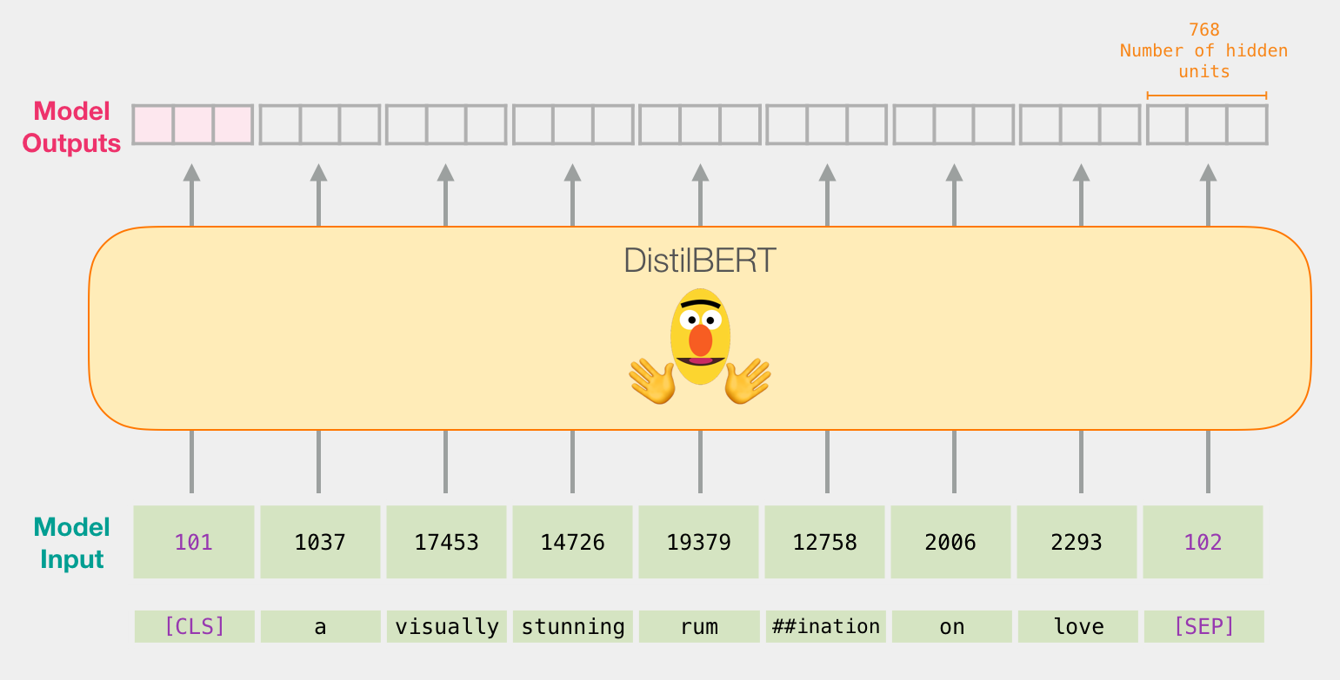

Slide 23
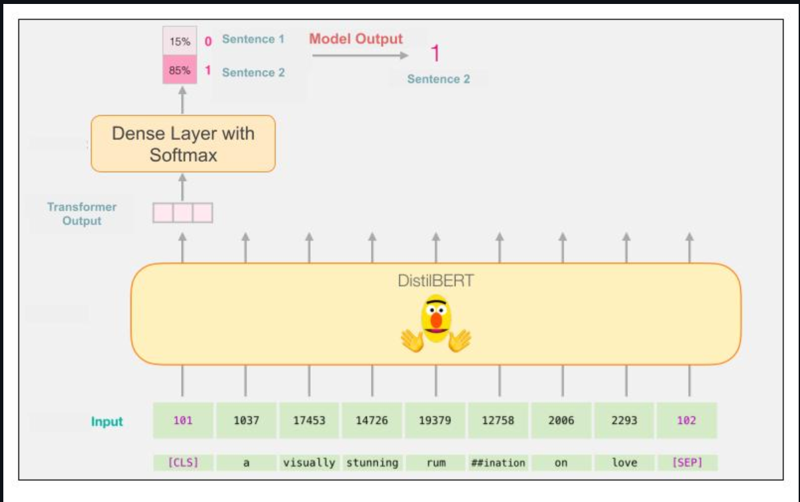

Slide 24
Training Parameters
We trained the DistilBERT model on training dataset for 5 epochs with a batch size of 16 with a learning rate of 2 x 10^-5.
We have used ‘accuracy’ as the metric to select the best model since our dataset is balanced

Slide 25
Using RoBERTa
To improve the training procedure, RoBERTa removes the Next Sentence Prediction (NSP) task from BERT’s pre-training and introduces dynamic masking so that the masked token changes during the training epochs. Larger batch-training sizes were also found to be more useful in the training procedure.
Importantly, RoBERTa uses 160 GB of text for pre-training, including 16GB of Books Corpus and English Wikipedia used in BERT. The additional data included CommonCrawl News dataset (63 million articles, 76 GB), Web text corpus (38 GB) and Stories from Common Crawl (31 GB).
As a result, RoBERTa outperforms both BERT and XLNet on GLUE benchmark results

Slide 26
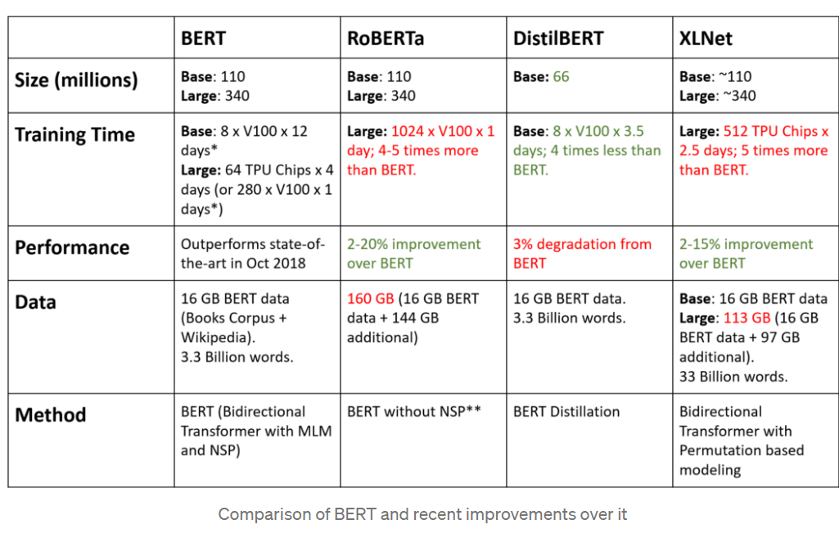

Slide 27
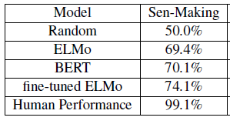
Comparing Accuracy of Models Used in Research Paper and our Methods
Research Paper ACL 2019
LSTM | 52.00%
DistilBERT | 82.04%
RoBERTa | 87.16%
Models trained and tested
By us

Slide 28
Conclusion
We have trained Sequence to Sequence, DistilBERT and RoBERTa models on train dataset and validated on validation dataset.
We have achieved an accuracy of 86.3% against the highest accuracy of 74.1% attained by the methodology used in research paper.
Hence, we have developed a system that can differentiate natural language statements which make sense from those that do not make sense to an accuracy of 86.3% on test dataset.

Slide 29
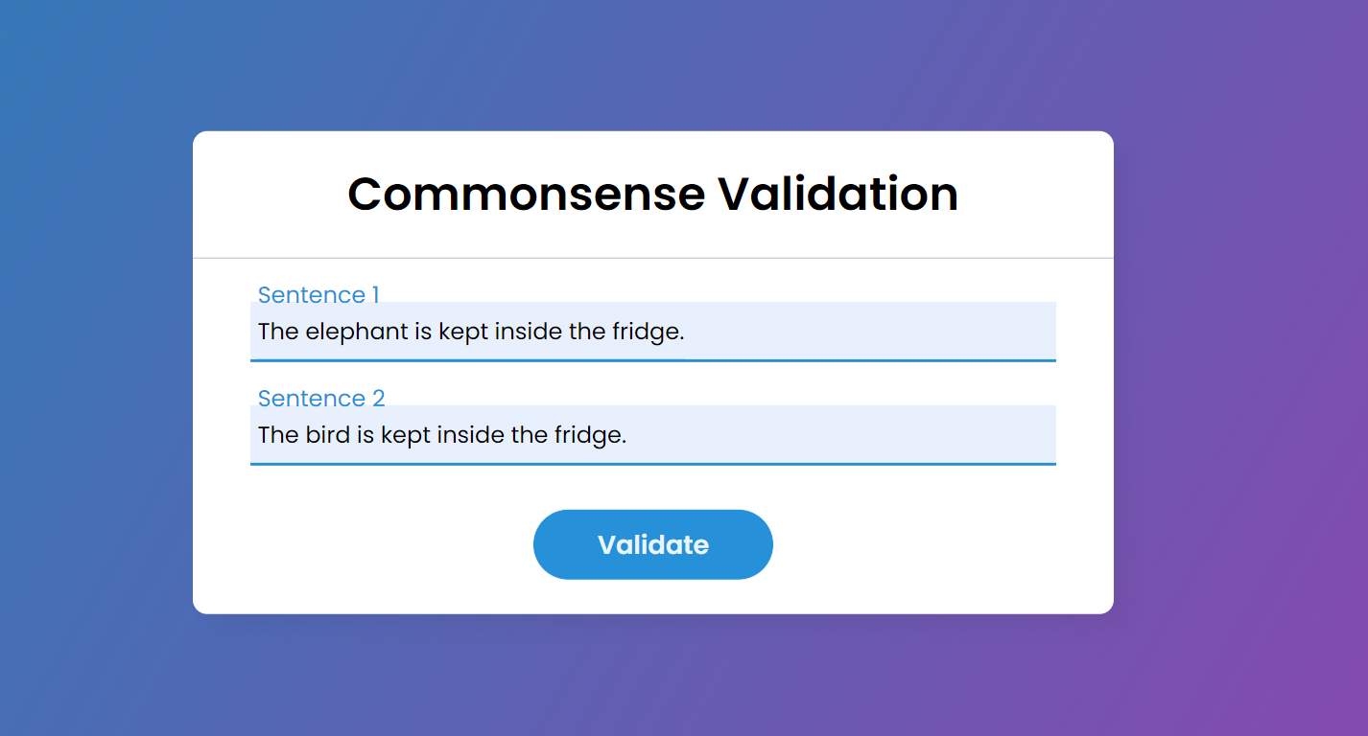

Slide 30
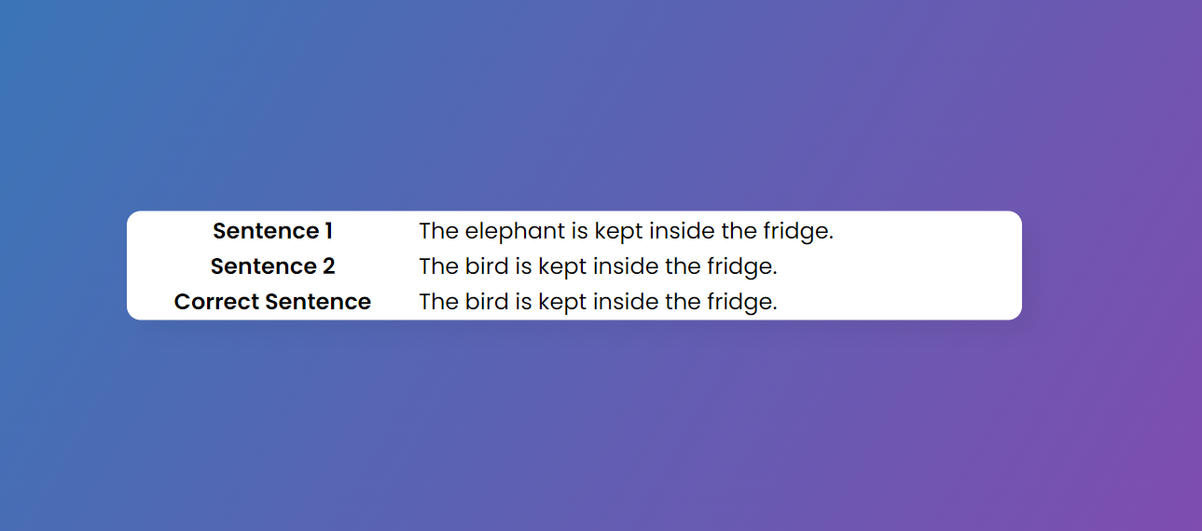

Slide 31
Applications
We can use the Commonsense Validation methodology to evaluate the sense-making capability of NLU models and compare and contrast between them.
Similar systems can be deployed in
Chatbots
Search Engines
to check if the phrases/sentences input by users makes sense or not. Hence, providing a better search experience.

Slide 32
Future Scope
Recent research papers have achieved greater accuracy by training large and complex Knowledge Attention Graph models on the given dataset. Training of such complex models is beyond the scope since we do not have sufficient infrastructure.
Following paper is one such example which shows the implementation of the above mentioned technique -
Zhao, Q., Tao, S., Zhou, J., Wang, L., Lin, X., & He, L. (2020). ECNU-SenseMaker at SemEval-2020 Task 4: Leveraging Heterogeneous Knowledge Resources for Commonsense Validation and Explanation. arXiv preprint arXiv:2007.14200.

Slide 33
References
Wang, C., Liang, S., Jin, Y., Wang, Y., Zhu, X., & Zhang, Y. (2020). SemEval-2020 task 4: Commonsense validation and explanation. arXiv preprint arXiv:2007.00236.
Codalab Competition - CodaLab - Competition
Knowledge-enhanced Graph Attention Network (KEGAT) - [2007.14200] ECNU-SenseMaker at SemEval-2020 Task 4: Leveraging Heterogeneous Knowledge Resources for Commonsense Validation and Explanation (arxiv.org)
Rationale-Inspired Natural Language Explanations with Commonsense - [2106.13876] Rationale-Inspired Natural Language Explanations with Commonsense (arxiv.org)
Word Embedding - Simple Tutorial on Word Embedding and Word2Vec | by Zafar Ali | Medium
A Visual Guide to Using BERT for the First Time – Jay Alammar – Visualizing machine learning one concept at a time. (jalammar.github.io)
The Illustrated Transformer – Jay Alammar – Visualizing machine learning one concept at a time. (jalammar.github.io)
Seq2Seq Model - https://www.analyticsvidhya.com/blog/2020/08/a-simple-introduction-to-sequence-to-sequence-models/
Sequence Models - https://cs230.stanford.edu/files/C5M3.pdf
BERT - https://towardsdatascience.com/keeping-up-with-the-berts-5b7beb92766
https://www.analyticsvidhya.com/blog/2021/06/why-and-how-to-use-bert-for-nlp-text-classification/
DistillBert - Smaller, faster, cheaper, lighter: Introducing DistilBERT, a distilled version of BERT | by Victor Sanh | HuggingFace | Medium
DistilBert - DistilBERT — transformers 2.11.0 documentation (huggingface.co)
BERT, DistilBERT, ROBERTA, XLNet - https://towardsdatascience.com/bert-roberta-distilbert-xlnet-which-one-to-use-3d5ab82ba5f8
BERT, DistilBERT, ROBERTA, XLNet - https://www.kdnuggets.com/2019/09/bert-roberta-distilbert-xlnet-one-use.html
https://towardsdatascience.com/to-distil-or-not-to-distil-bert-roberta-and-xlnet-c777ad92f8
https://datascience.stackexchange.com/questions/97310/what-is-the-difference-between-bert-and-roberta
Evaluating Roberta Model - https://github.com/pytorch/fairseq/issues/1324
Deep Learning Stanford University Course - CS230: Deep Learning | Autumn 2018 - YouTube
Making Web Apps using Flask - How to Deploy Machine Learning Models using Flask (with Code) (analyticsvidhya.com)

Slide 34
THANK YOU

